Slide 1
MICROSOFT EXCEL

Slide 2
Topics
What is Excel ?
Excel Visual Representation
Excel Interface
Basic Formatting
Excel Formulas
Save File
Protecting Workbook & Worksheet
Clean and Trim
Filter and Sort
Conditional Formatting
Insert or delete rows and columns in Excel
Find and Remove Duplicates
Merge & Center
Rounding of Numbers
Autofill
Comments
Insert Table
Slicer
Insert Picture or Shapes
Add link or hyperlink
Split Text
Charts in Excel
VLOOKUP
Pivot Table

Slide 3

WHAT IS MS EXCEL ?
Microsoft Excel is a spreadsheet program that helps users organize, format, and calculate data. It's part of the Microsoft 365 suite of software, which also includes Word, PowerPoint, Teams, and Outlook.
It provides a user-friendly way to analyse and work with data.
It is an electronic spreadsheet with numerous rows and columns, used for organizing data, graphically representing data(s), and performing different calculations.
Excel is essential for tasks in finance, accounting, data analysis, project management, and more, due to its versatility and ease of use.

Slide 4
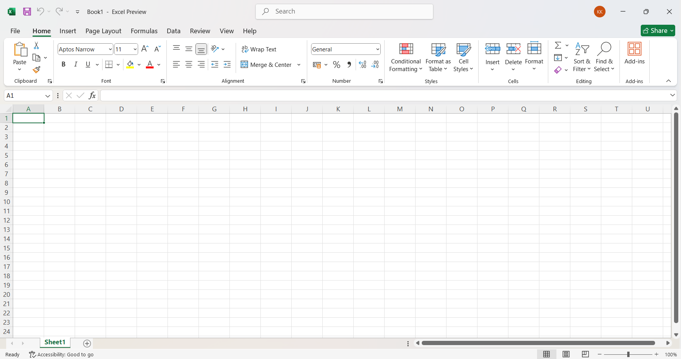
Excel Visual Representation

Slide 5
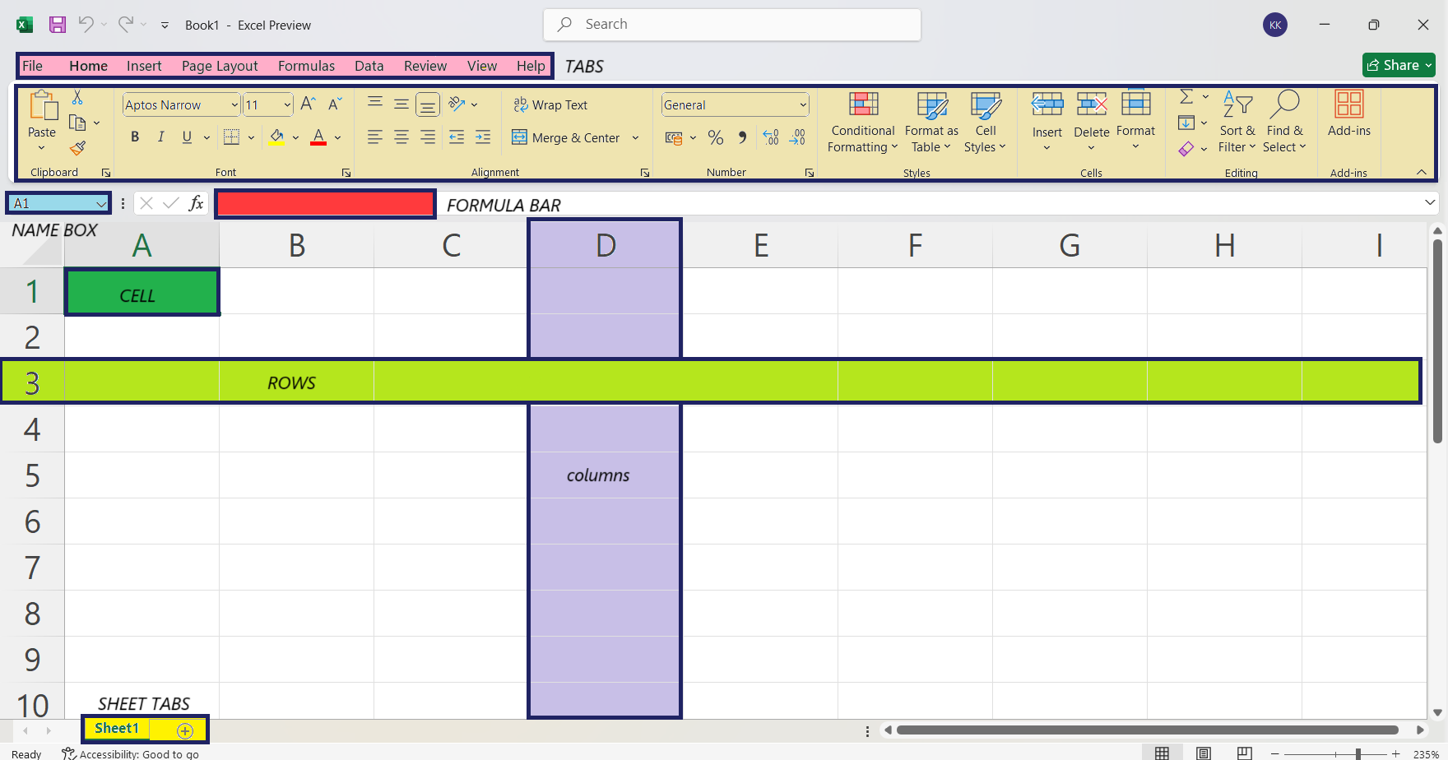
Excel Interface

Slide 6
Basic formatting
Excel offers a variety of formatting options to enhance the appearance and readability of your data. Here are some common formatting techniques:
Font Formatting: Font, Font Size, Font Color, Bold, Italic, Underline, Text Wrap, Merge Cells
Number Formatting: General, Number, Currency, Percentage, Date, Time, Custom
Alignment: Horizontal Alignment, Vertical Alignment, Wrap Text, Indent
Cell Borders: Border, Border Style, Border Color
Conditional Formatting: Highlight cells based on certain conditions

Slide 7
Excel formulas
Basic Arithmetic Formulas : Addition: =A1 + B1, Subtraction: =A1 - B1, Multiplication: =A1 * B1, Division: =A1 / B1, Exponentiation: =A1 ^ B1
Common Functions : SUM: =(A1:A10), AVERAGE: =AVERAGE(A1:A10), COUNT: = COUNT(A1:A10), COUNTA: =COUNTA(A1:A10), MAX: =MAX(A1:A10), MIN: =MIN(A1:A10), IF: =IF(A1>50, “PASS”, “FAIL”)
Text Functions : CONCATENATE/CONCAT: =CONCAT(A1, “ ”, B1), LEFT: =LEFT(A1,5), RIGHT: =RIGHT(A1,5), MID: =MID(A1, 3, 5), LEN: =LEN(A1), SEARCH/FIND: =SEARCH(“mukul”, A1)
Date and Time Functions : TODAY: =TODAY(), NOW: =NOW(), DATEDIF: =DATEDIF(A1, B1, “D”), DAY: =DAY(A1), MONTH: =MONTH(A1), YEAR: =YEAR(A1)
Logical Functions : AND: =AND(A1>10, B1<5), OR: =OR(A1>10, B1<5), NOT: =NOT(A1>10)

Slide 8
Save file
.
To save a file in Excel, follow these steps:
Step 1: Click on the File tab in the top-left corner of Excel.
Step 2: Select Save As from the menu.
Step 3: Choose a location where you want to save the file (e.g., This PC, OneDrive, Browse).
Step 4: In the Save As dialog box, enter a name for your file in the File name field.
Step 5: Select the file format from the Save as type dropdown (e.g., .xlsx for a standard Excel workbook, .csv for a comma-separated values file, .xlsm for a macro-enabled workbook).
Step 6: Click Save.
To save updates to an existing file, simply click the Save icon in the top-left toolbar or press CTRL+S on your keyboard. Excel will automatically update the existing file.

Slide 9
Protecting Workbook & Worksheet In Excel, you can protect both the workbook and individual sheets to prevent accidental or unauthorized changes.
WORKBOOK
Go to the Review tab on the ribbon.
Click Protect Workbook.
A dialog box will appear with options.
Enter a password if you want to restrict who can unprotect the workbook.(Optional)
Click OK. If you entered a password, you'll be asked to confirm it.
WORKSHEET
Go to the Review tab on the ribbon.
Click Protect Sheet.
A dialog box will appear with several options
Enter a password if you want to restrict who can unprotect the sheet. (Optional)
Click OK. If you entered a password, you'll be asked to confirm it.

Slide 10
Clean and trim
In Excel, data cleaning is an essential step to prepare data for analysis. Two commonly used functions for cleaning data are CLEAN and TRIM, which help to remove unwanted characters and extra spaces from text.
CLEAN()
The CLEAN function removes all non-printable characters (such as line breaks, tabs, etc.) from the text.
=CLEAN(text)
TRIM()
The TRIM function removes extra spaces from text, leaving only single spaces between words.
=TRIM(text)

Slide 11
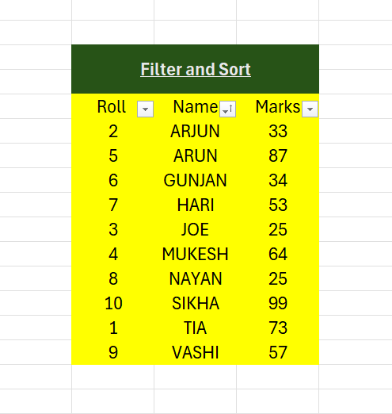
FILTER & SORT
In Excel, filtering and sorting are essential tools for organizing and analysing data efficiently.
Sorting : Sorting helps to rearrange data either in ascending or descending order. You can sort by one or multiple columns.
Filtering: Filtering helps to display only the rows that meet certain criteria, hiding the rest. A small dropdown arrows will appear in each header cell.

Slide 12
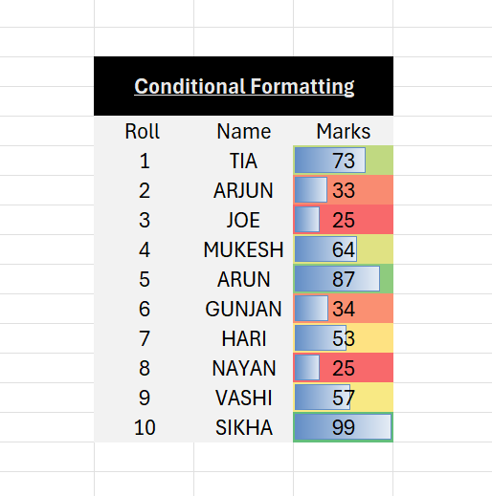
CONDITIONAL FORMATTING
Conditional Formatting in Excel is a feature that automatically applies formatting (such as colors, icons, or data bars) to cells based on the values they contain. It helps to highlight important data trends or patterns, making it easier to analyze and interpret large datasets.

Slide 13
insert or delete rows and columns in Excel
Inserting Rows or Columns
Select the row or column where you want to insert a new one.
Right-click on the selected row or column header and choose "Insert".
Press CTRL+ : A new row or column will be inserted before the current position.
Deleting Rows or Columns
Select the rows or columns you want to delete.
Right-click on the selected rows or columns and choose "Delete".
Press CTRL- : The selected row or column will be removed.

Slide 14
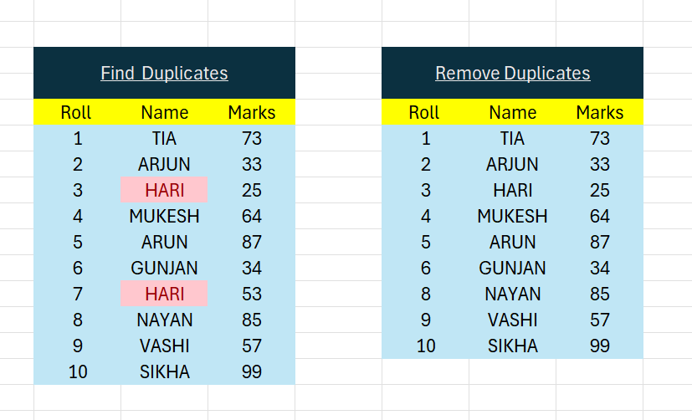
Find and remove duplicates
Find Duplicates Using Conditional Formatting :
Go to the Home tab, and in the Styles group, click on Conditional Formatting. → Select Highlight Cells Rules, then click Duplicate Values. → Choose how you want the duplicates to be highlighted (formatting options). → Click OK.
Remove Duplicates :
Go to the Data tab. → In the Data Tools group, click Remove Duplicates. → A dialog box will appear. Ensure the correct columns are selected where you want to check for duplicates. →Click OK.

Slide 15
Merge & center
To Merge and Center cells in Excel, follow these steps:
Select the cells you want to merge.
Go to the Home tab on the Excel ribbon.
In the Alignment group, click on the Merge & Center button.

Slide 16
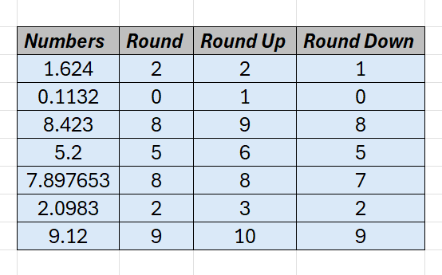
Rounding of numbers
ROUND Function : Rounds a number to the nearest integer.
ROUNDUP Function : Rounds a number up to the nearest integer.
ROUNDDOWN Function : Rounds a number down to the nearest integer.

Slide 17
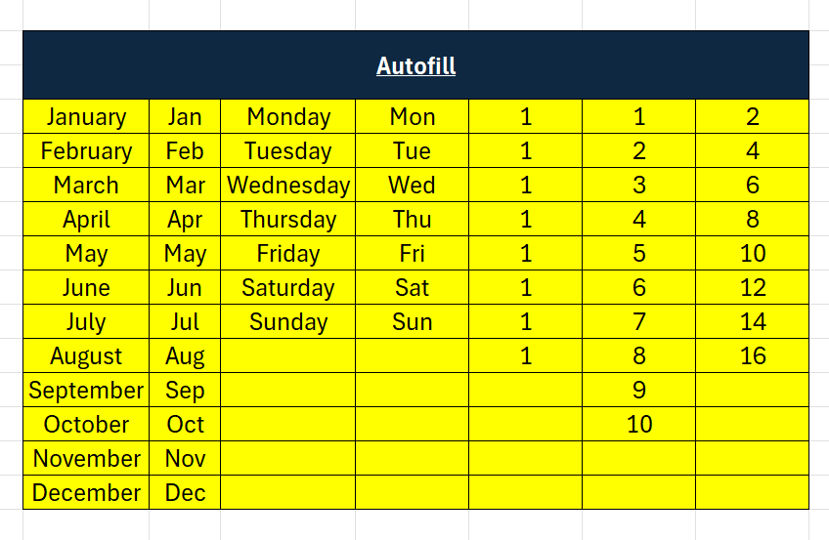
Autofill
In Excel, AutoFill allows you to quickly fill cells with repetitive or sequential data, such as numbers, dates, formulas, and text.
Basic Steps for AutoFill:
Enter the starting value(s) in a cell or range of cells.
Select the cell or range you want to auto-fill.
Hover over the bottom-right corner of the selection until the small black cross (Fill Handle) appears.
Drag the fill handle down, up, or across to the cells where you want the data filled.
Release the mouse, and Excel will fill the selected cells with a sequence or pattern.

Slide 18
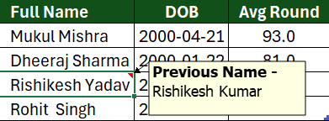
Comments
In Excel, you can add comments to cells to provide additional context or explanations.
Inserting Comment :
Right-click the cell where you want to add a comment.
Select New Comment.
Type your comment in the box that appears.
Press Enter or click outside the comment box to save it.

Slide 19
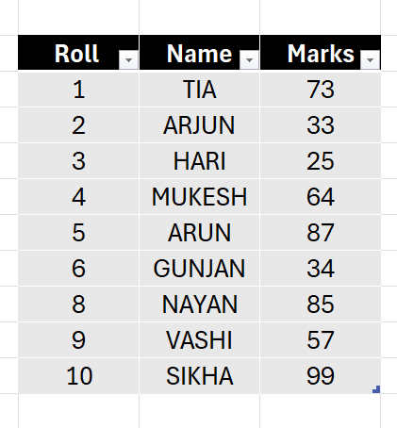
Insert table
Inserting a table in Excel is a way to visually organize and structure your data.
Here's how you can do it:
Select the data range: Choose the cells you want to include in your table.
Insert a table:
Method 1: Go to the Insert tab, then click Table
Method 2: Select the data, then press Ctrl+T (Windows)
Confirm the range: Check if the selected range is correct and if you want the first row to be headers
Click OK: Your data will be converted into a table.

Slide 20
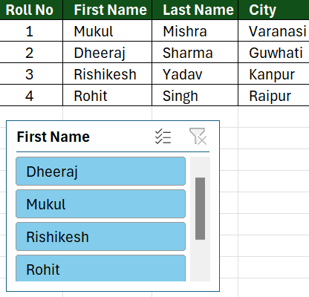
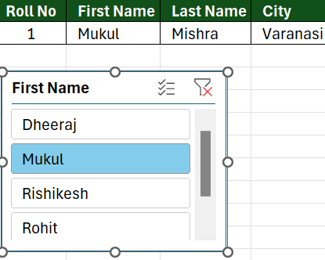
Slicer
A slicer in Excel is a powerful tool that allows you to quickly filter and analyze data within a table. It provides a visual way to interact with your data and see different subsets based on selected criteria.
How to create a slicer:
Select your table: Click anywhere within your table to select it.
Go to the Insert tab, then click Slicer.
Choose fields: In the Create Slicers dialog box, select the columns you want to include in your slicer.
Click OK: Your slicers will be inserted into your worksheet.

Slide 21

Insert picture or shapes
We can easily enhance your Excel worksheets by adding pictures and shapes to visualize data, create diagrams, or add decorative elements.
Inserting a Picture: Click on the "Insert" tab → Choose the Picture option → Browse and select the image → Resize and reposition.
Inserting a Shape: Click on the "Insert" tab → Choose the Shapes option → Select a shape → Draw the shape → Format the shape.

Slide 22
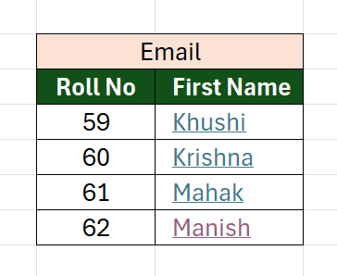
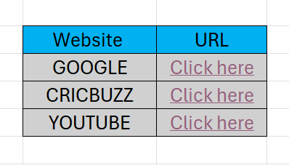
Add link or hyperlink
.
We can add hyperlinks in Excel to link to websites, other cells, files, or email addresses.
Steps to Insert a Hyperlink in Excel:
Select the Cell
Go to the Insert Tab
Click Hyperlink
Choose What to Link To:
Existing File or Web Page
Place in This Document
Email Address
Click OK

Slide 23
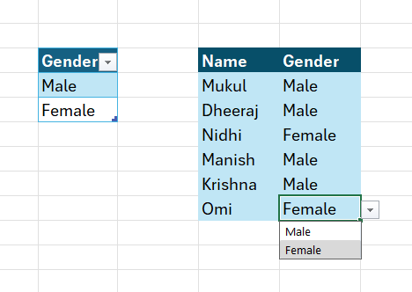
Drop-down list
A drop-down list in Excel is a type of data validation that provides a predefined list of options for users to choose from. This feature is useful for limiting input to specific values, making data entry more consistent and accurate.
Creating a Drop-Down List:
Select the range of cells.
Go to the "Data" tab, then click "Data Validation".
In the "Data Validation" dialog box, select "List" from the "Allow" drop-down menu.
Enter the list source.
Click OK: Your drop-down list will be created, and a small arrow will appear in the selected cells.

Slide 24
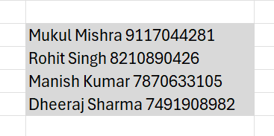
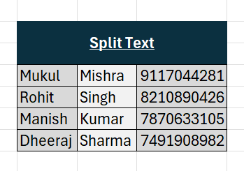
Split text
Splitting text in Excel refers to dividing a single cell's content into multiple cells based on specific criteria.
Steps:
Select the cell(s) containing the text you want to split.
Click the Data tab in the Ribbon.
Click Text to Columns.
Choose Delimited.
Select the delimiter you want to split by (e.g., comma, space, etc.).
Click Next and Choose Destination.
Click Finish: The text will be split into multiple columns based on the delimiter or width you specified.
We can also Split Text by Formulas Using LEFT(), RIGHT(), and MID().

Slide 25
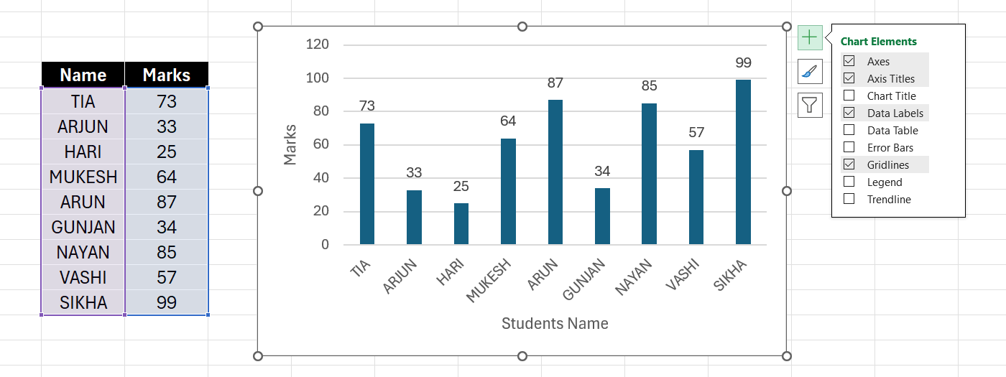
CHARTS IN EXCEL
Charts are a powerful tool in Excel that allow you to visually represent your data, making it easier to understand trends, patterns, and relationships. Excel offers a wide variety of chart types to suit different data visualization needs.
Steps : Select your data → Insert a chart → Customize your chart

Slide 26
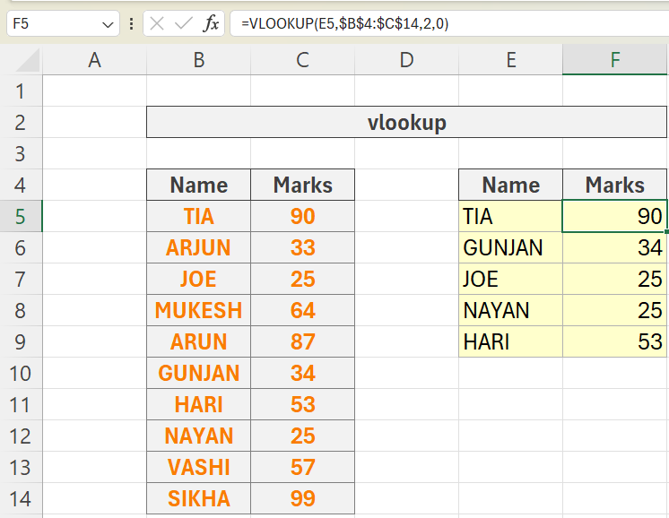
vlookup
VLOOKUP is a powerful function in Excel that allows you to search for a value in a table and return the corresponding value from a different column. It's a great tool for looking up data based on a specific criterion.
Syntax:
VLOOKUP(lookup_value, table_array, col_index_num, [range_lookup])

Slide 27
PIVOT TABLE
Pivot Tables in Excel: A Powerful Tool for Data Analysis
Pivot tables are a dynamic data analysis tool in Excel that allow you to summarize and analyze large datasets quickly and efficiently. They are particularly useful for aggregating data, calculating totals and averages, and creating various reports.
Benefits of Pivot Tables:
Quickly summarize large datasets.
Dynamic and interactive data analysis.
Easily rearrange fields to explore different views of the data.
Enhanced Data Visualization
Time-Saving

Slide 28
Steps to Create a Pivot Table:
Prepare your data: Ensure your data is in tabular format (rows and columns), with headers for each column.
Select the data range: Highlight the data range or select the whole table.
Go to the Insert tab in Excel and Click PivotTable.
In the dialog box, select the range (if not already selected) and choose where you want to place the Pivot Table (New Worksheet or Existing Worksheet).
Field Placement: You drag and drop fields from your data source into different areas of the pivot table.
Here, you can drag and drop fields into four main areas: Rows, Columns, Values, and Filters.

Slide 29
